Slide 1
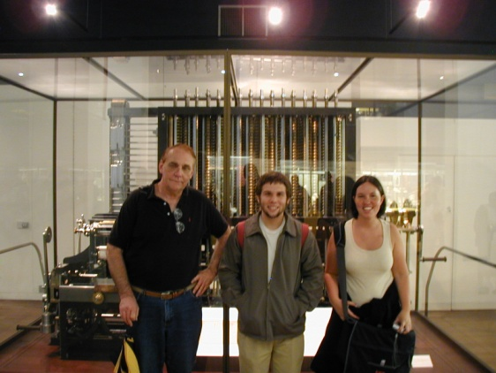
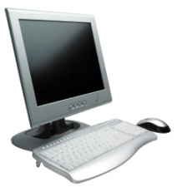
TSYS School of Computer Science Teacher Workshop December 2009
Wayne Summers, Columbus State University

Slide 2
The number of Computer Science majors has dropped 40-50% nationwide since 2001
The percentage of women has dropped to about 10%
From a high of about 40% in the early 80s
Projections of 46% job growth over the next 10 years!

Slide 3
Challenge
“Finding a way to attract new talent to develop the new systems and applications that are becoming available from major vendors and startups alike may be the biggest technological issue we face for the rest of the decade.”
Editorial Director Eric Lundquist, eweek.com, May 7, 2007.

Slide 4
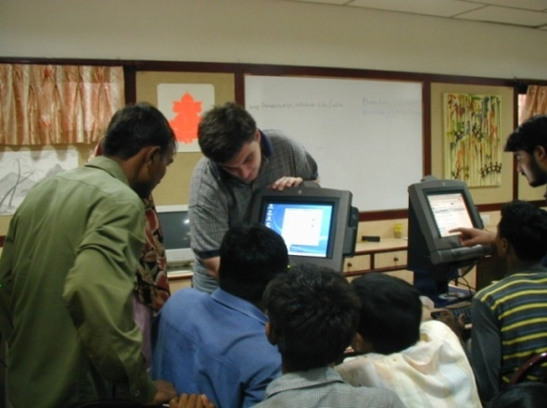
Myth #1
All computing jobs are going overseas
Only about 1-2% have
There are actually more jobs now in computing than in 2001
The US Labor Department predicts that computer software engineers and computer systems designers will be among the fastest growing occupations in 2002-2012

Slide 5
1. Network systems and data communications analyst | 6. Database administrator
2. Physician assistant | 7. Physical therapist
3. Computer software engineer, applications | 8. Medical scientist
4. Computer software engineer, systems software | 9. Occupational therapist
5. Network and computer systems administrator | 10. College instructor
The 10 fastest-growing jobs between now and 2014 http://money.cnn.com/magazines/business2/nextjobboom/

Slide 6
Occupations with the Most Job Openings: Bachelor's Degrees
Occupation Total Job Openings 2006-2016
Elementary school teachers, except special education 545,000
Accountants and auditors 450,000
Secondary school teachers, except special and vocational education 368,000
Computer software engineers, applications 300,000
Computer systems analysts 280,000
Middle school teachers, except special and vocational education 217,000
Network systems and data communications analysts 193,000
Securities, commodities, and financial services sales agents 161,000
Network and computer systems administrators 154,000

Slide 7
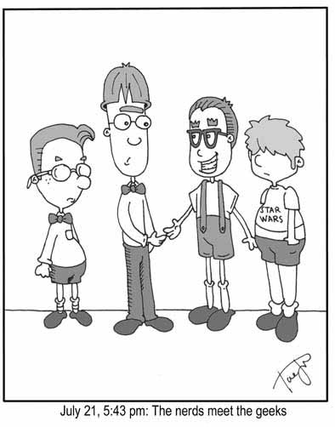
Myth #2
Only geeks do well in computing

Slide 8
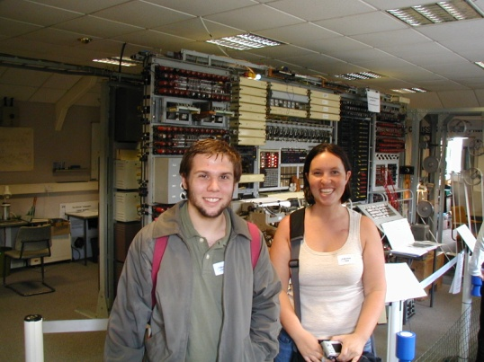
Trick question:
What was the average
weight of a computer in
the early 1940’s?

Slide 9
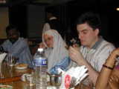
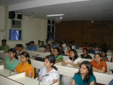
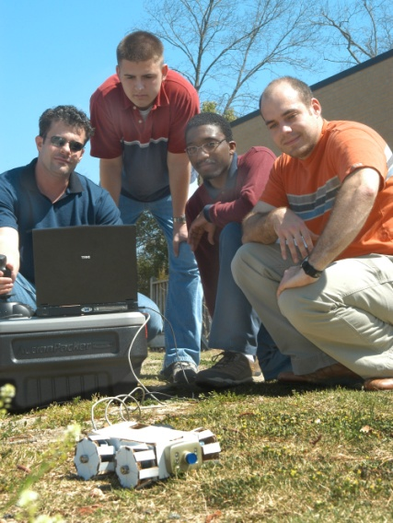
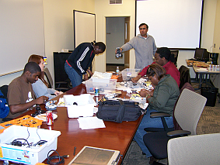
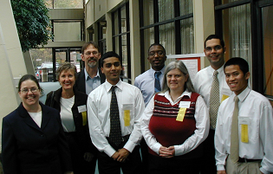
Who is in Computer Science?

Slide 10
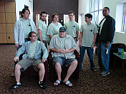
Myth #3
You have to like to play computer games
Professionals in computing
Say that you should like:
Problem solving
Working with others in a team
Being creative

Slide 11
At Google, Amazon, and Microsoft

Slide 12
Myth #4
The job is boring!
Introductory classes are often boring
Students find the examples irrelevant, and tedious – but that is changing
Computer Science juniors are often surprised how creative it is
Once you are past the early classes
Example: Computing Graphics, Game Programming, Artificial Intelligence…

Slide 13
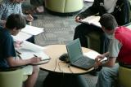
Money Magazine rated software engineer the #1 job in 2006
Flexibility: pick your hours
Creativity: highest grade of any job
Growth 44,800 average job openings a year
Average Pay: $80,500 to 6 figures
Computer IT Analyst was #7
Top 10 best jobs http://money.cnn.com/magazines/moneymag/bestjobs/

Slide 14
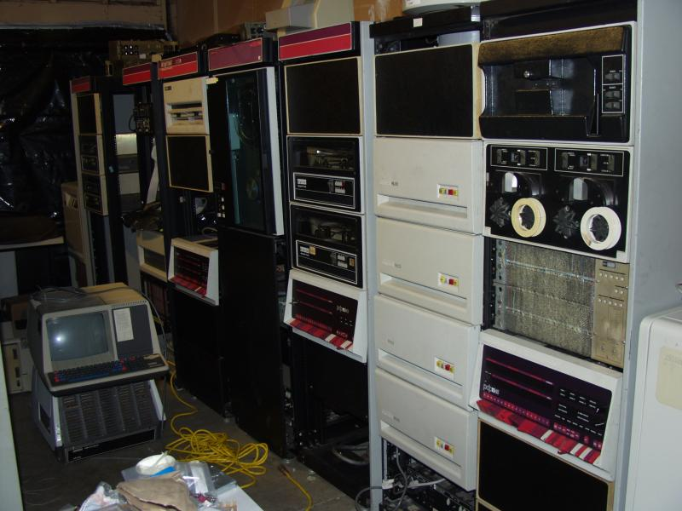
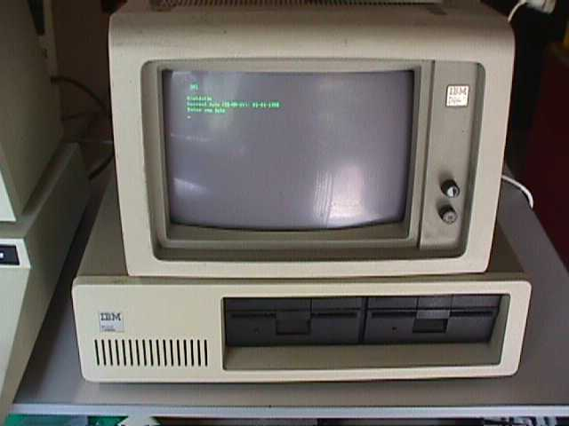
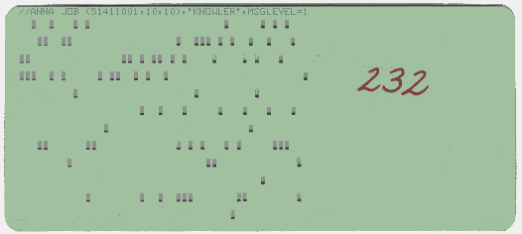
What Computing Was in 70-80s

Slide 15
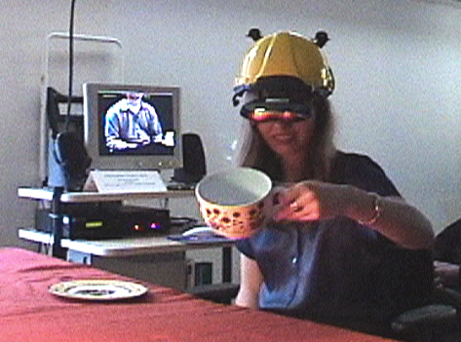
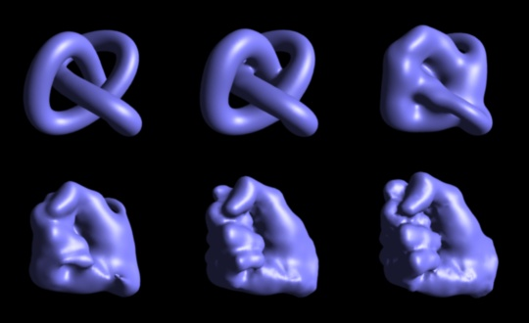
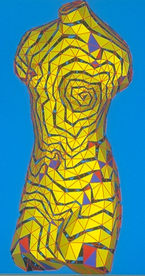
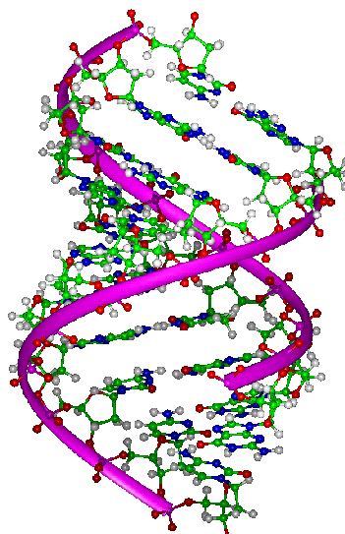
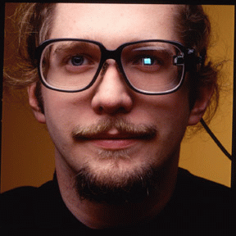
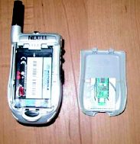
What Computing is Today
Virtual Environments
Graphics
Bioinformatics
Wearable Computing

Slide 16
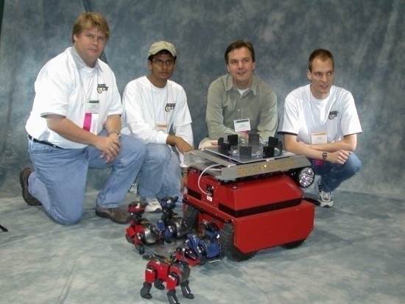
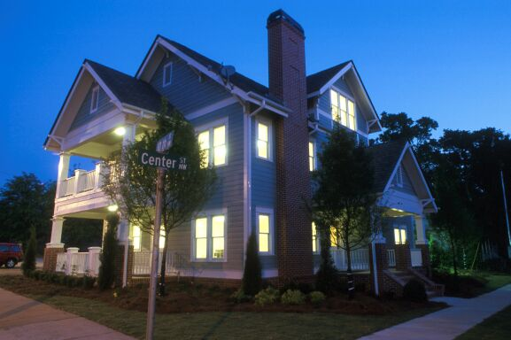
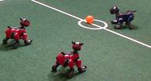
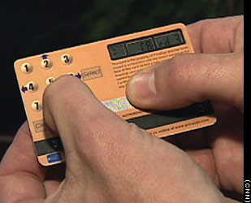
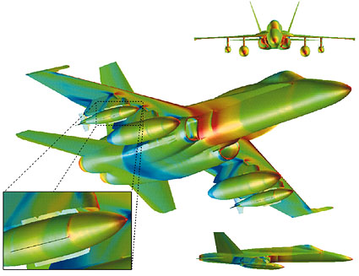
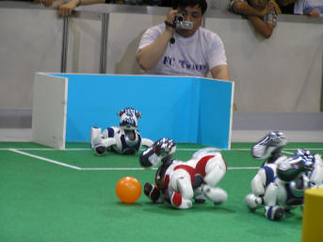
What Computing is Today
Ubiquitous Computing
Databases
Information Security
High Performance Simulation

Slide 17
The PC of tomorrow
Video:
Microsoft Surface: http://www.microsoft.com/surface/ MIT Media Lab's "Sixth Sense“: http://video.computerworld.com/services/player/bcpid1351827287?bctid=14706015001

Slide 18
Bachelor of Science in Computer Science
Systems
designed for students who plan on continuing to a graduate program in Computer Science or who want a more traditional and theoretical degree
Applied
less theoretical with a focus on mainframe programming and web programming
Games
designed for students who plan on continuing to a graduate program in Computer Science or who want to work in the gaming industry
Minor Computer Science (18 semester hours)
Academic Programs in Computer Science

Slide 19
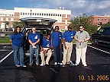
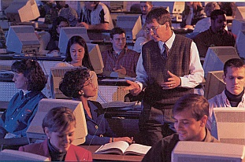
Bachelor of Science in Information Technology
provides students with a combination of knowledge, hands–on experience, and application of theory.
The curriculum emphasizes quantitative and communication skills as well as providing a basic foundation in understanding the business process and the role of Information Technology in supporting that process.

Slide 20
Undergraduate curriculum modeled after ACM Computing Curriculum with input from industry
Our curriculum in Information Assurance has been recognized by the National Security Agency (NSA) as meeting their criteria for training Information Systems Security Professionals and Information Systems Security Officers.
Quality of Academic Programs

Slide 21
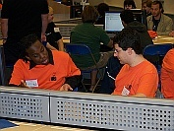
Software Engineers / Architects
(Most Satisfying Job Rating by CNN Survey 4/13/07)
Computer Programmers / Software Developers
Java, C++, VB, C#, .NET, COBOL, Assembler,...
Game Programmers
Web Developers
Systems Analysts
Database Administrators
Network Managers
Computer and Network Security Specialists
Students are educated to be:

Slide 22
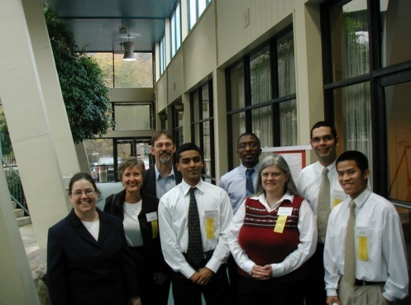
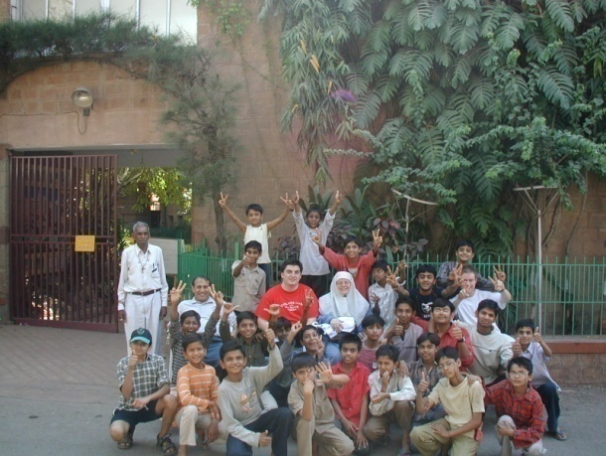
Approximately 300 undergraduates
TSYS Foundation Scholarships
Student research opportunities
Variety of internship and coop opportunities
Study-abroad opportunities
ACM Student Chapter
Programming Competition
Invited Speakers
Educational Tours
Columbus Regional Technology Center (Incubator)
Computer Science Students

Slide 23
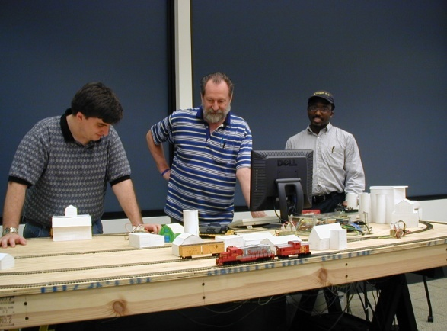
Wireless and Network Security
Honorable mention in Undergraduate presentations at ACM-MidSoutheast (2009)
Second place in Graduate presentations at ACM-MidSoutheast (2008)
Third place in Undergraduate presentations at ACM-MidSoutheast (2005)
Third place in student presentations at InfoSecCD (2005)
Database Security
Game Development / Simulation
Third place in Undergraduate presentations
at ACM-MidSoutheast (2009)
Embedded Computing
Software Evaluation project
Legacy Code Transformation
Ubiquitous Computing
First place in Undergraduate presentations at ACM-MidSoutheast (2004)
Student research opportunities

Slide 24
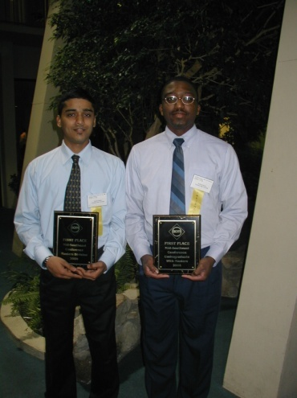
Columbus Waterworks
AFLAC
TSYS
Synovus
Ft. Benning Virtual Soldier Lab
Ft. Benning Martin Army Hospital
Columbus Ledger-Enquirer
Wellpoint
Georgia Power
CSU
Cubic (Omega Training)
Internship and coop opportunities

Slide 25
What you should study in H.S.?
Mathematics
Science (chemistry, physics, computer science)
Writing and Speech classes
Foreign Language classes

Slide 26
Computer engineering: will typically involve software and hardware and the development of systems that involve both software, hardware, communications
Computer science: currently the most popular of the computing disciplines, tends to be relatively broad and with an emphasis on the underlying science aspects.
Information systems: essentially this is computing in a business context
Information technology: computing in support, and will tend to involve a study of systems (perhaps just software systems, but perhaps also for instance systems in support of learning, of information dissemination, etc.)
Software engineering: based on software and involves employing certain ideas from the world of engineering in building reliable software systems

Slide 27
QUESTIONS?
Wayne Summers
Computer Science Dept. – CSU
568-2410
summers_wayne@colstate.edu

